Slide 1
Welcome! Fall 2023
This Photo by Unknown Author is licensed under CC BY-NC-ND

Slide 3
Fall 2023 General Meeting

Slide 4
SOCCCD Faculty Association
Fall 2023
Staff Development-week
All-Faculty Meeting

Slide 5
Faculty Association Officers
Melanie Haeri, President
Robert Melendez, President Elect
Frank Gonzalez, Treasurer
Marianne Wolfe, Secretary
Lewis Long, Past President
Jenny Langrell, Membership Chair
TBD, Part-time Faculty Chair
Claire Cesareo, Chief Negotiator

Slide 6
Grievance Chairs
IVC
Kathy Schmeidler
Bill Etter
Saddleback
Mark Blethen
Bill McGuire

Slide 7
Reps - Their Role and Importance
Elected position in April
Two-year term
Commitment: Rep Council meeting – once a month with the officers for updates and votes. First meeting – 9/11
Your representation on the issues!
They vote ! Make your voices and ideas known – through your rep

Slide 8
Changes to the FA By Laws
Additional division/school size level with more votes
Votes can now be apportioned as the rep sees fit, based on conversations within their school or division

Slide 9
Representative Council
Saddleback College (Old Configruation)
Advanced Technology and Applied Science: Kathleen Lunetto
Business Science and Economic Workforce Development: Don Bowman
Brock Schermerhorn, alternate
Counseling Services: Paris Peck
Mike Long, alternate
Emeritus Institute: Jill Ibbotson
Fine Arts and Media Technology: Bill McGuire
Health Sciences and Human Services: Janine O’Buchon
Loretta Niccola, alternate
Kinesiology and Athletics: Matt Sherman
Student Equity & Special Programs : Michael Hoggatt
Liberal Arts: Vacant
Mathematics, Science and Engineering: Sam Abbas
Frank Gonzalez, alternate
Online Education and Learning Resources: Jenny Langrell
Lydia Tamara, alternate
Social and Behavioral Sciences: Allison Camelot
Caroline Gee, alternate

Slide 10
Representative Council
Irvine Valley College
Arts: Vacant
Business Sciences: Rick Boone
Guidance and Counseling: Javier Valdez, Parisa Soltani, alternate
Humanities: Daniel Vernazza;
Kinesiology, Health and Athletics: Ted Weatherford;
Languages and Learning Resources: Amanda Jerome, Savyonne Steindler, alternate
Life Sciences and Technologies: Kathy Schmeidler, Amy McWhorter, alternate
Math, Computer Sciences and Engineering: Carlo Chan
Physical Science and Technology: Amy Stinson
Social and Behavioral Sciences: Adam Ghuloum
IDEA: Massimo Mitolo

Slide 11
Representative Council
Saddleback (New Configuration)
Counseling Services: Paris Peck OR Michael Hoggatt
Mike Long, alternate
Extended Learning Division: Jill Ibbotson (to be voted on Sept. 12)
Kinesiology and Athletics Division: Matt Sherman
Instructional Support and Teaching Innovations Division: Jenny Langrell
Lydia Tamara, alternate
School of Arts, Media, Performance, and Design: Bill McGuire
School of Business and Industry: Don Bowman OR Kathleen Lunetto
Brock Schermerhorn, alternate
School of Health and Wellness: Janine O’Buchon
Loretta Niccola, alternate
School of Humanities and Social Sciences: Allison Camelot
Caroline Gee, alternate
School of Science, Technology, Engineering, and Math: Sam Abbas
Frank Gonzalez, alternate

Slide 12
Representative Council
Part-time Representatives
Nancy Allah
Susan Bliss
Karyn Bower
Jo Ann Noyes

Slide 13
No Rep OR New Division or Configuration ???
Discuss at your school/division meeting!
Send names to mwolfe10@ivc.edu
If there is 1 volunteer – we will vote at first rep council to seat them
If 2 volunteers, choose one as alternative, and we will vote at first rep council meeting to seat them
If 3 + volunteers (WOW!), we will run a special election.

Slide 14
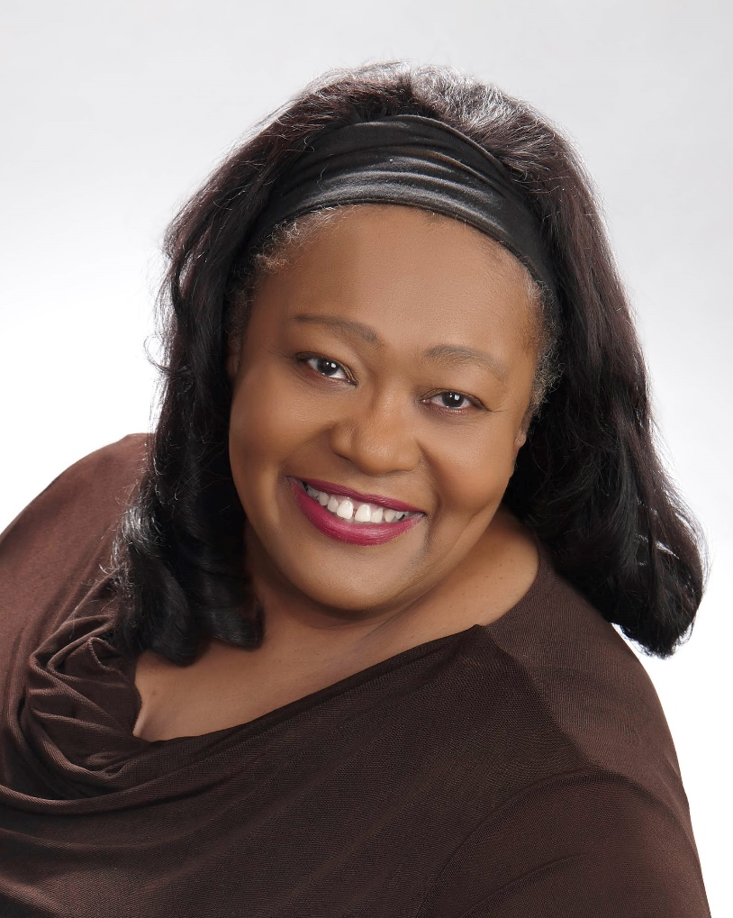
GUEST SPEAKER: PATRICIA RUCKER
LEGISLATIVE UPDATE
Patricia Rucker is a CTA Legislative Advocate in the areas of professional rights and responsibilities; assessment and testing; adult alternative, career & technical education and federal issues related to Elementary and Secondary Education. She has also worked for CTA as an Instruction and Professional Development Consultant: serving as a resource to CTA staff in the development of chapter training programs; providing advice to leaders and members on problems involving CTA policy, member rights and organization and communications.

Slide 15
Negotiations Update Claire Cesareo
ARTICLE 30 – WAGES – (COLA Adjustment)
New State COLA for 2023-2024 is 8.22%
We received the projected 3.11% in the initial contract negotiations
The adjusted salary schedule now includes the additional 5.11%
UPCOMING CONTRACT – Negotiations begin on September 1st!

Slide 16
KEEP IN TOUCH!
Socccdfa.net – our website with info and email: facultyassociation@socccd.edu
mhaeri0@ivc.edu – email me anytime
Contact your school/Division Rep
Contact a grievance chair
Attend Rep Council meetings – First Mondays of the month – open meetings
Fall 2023: Sept 11, Oct 2, Nov 6, Dec 4
Spring 2024: Feb 5, Mar 4, Apr 1, May 6
Attend Board of Trustee meetings – Last Monday of the month – open meetings

Slide 17
HAVE A GREAT SEMESTER!

Slide 18
QUESTIONS???

