Slide 1
Welcome! Spring 2024
This Photo by Unknown Author is licensed under CC BY-NC-ND

Slide 3
Spring 2024 General Meeting

Slide 4
SOCCCD Faculty Association
Spring 2024
Staff Development-week
All-Faculty Meeting

Slide 5
Faculty Association Officers
Melanie Haeri, President
Robert Melendez, President Elect
Frank Gonzalez, Treasurer
Marianne Wolfe, Secretary
Lewis Long, Past President
Jenny Langrell, Membership Chair
Joanna Kibler-McNerney, Part-time Faculty Chair
Claire Cesareo, Chief Negotiator

Slide 6
New Officer Elections – April – 2-year term
President-Elect – 2 years + 2 years as president + 2 years past president
Treasurer
Secretary
Membership Chair

Slide 7
Grievance Chairs - (appointed position)
IVC
Kathy Schmeidler
Bill Etter
Saddleback
Mark Blethen
Bill McGuire

Slide 8
Reps - Role and New Term!
Elected position in April - not just volunteer at School meeting like other committees
Two-year term – ends this May – New term begins in fall.
Commitment: Rep Council meeting – First Monday of the month beginning in September with the officers for updates and votes.
Your representation on the issues!
They vote ! Make your voices and ideas known – through your rep
It’s time to Prepare for April Election – Send names to Marianne Wolfe : mwolfe10@ivc.edu. Details of dates and details for sending nominees…. Later in presentation – Frank Gonzalez

Slide 9
Representative Council
Saddleback College
Business and Industry: Emily Quinlan
Kathleen Lunetto, alternate
Counseling Services: Paris Peck
Mike Long, alternate
Emeritus Institute: Jill Ibbotson
Arts, Media, Performance, and Design: Bill McGuire
Health Sciences and Human Services: Janine O’Buchon
Loretta Niccola, alternate
Kinesiology and Athletics: Matt Sherman
Liberal Arts: VACANT
Mathematics, Science and Engineering: Sam Abbas
Frank Gonzalez, alternate
Online Education and Learning Resources: Jenny Langrell
Lydia Tamara, alternate
Humanities and Social Science: Allison Camelot
Pete Murray, alternate

Slide 10
Representative Council
Irvine Valley College
Arts: VACANT
Business Sciences: Rick Boone
Guidance and Counseling: Javier Valdez
Parisa Soltani, alternate
Humanities: Lisa Alvarez
Deanna Scherger, alternate
Kinesiology, Health and Athletics: Ted Weatherford
Languages and Learning Resources: Savyonne Steindler
Life Sciences and Technologies: Kathy Schmeidler
Pierre Nguyen, alternate
Math, Computer Sciences and Engineering: Carlo Chan
Physical Science and Technology: Amy Stinson
Social and Behavioral Sciences: Adam Ghuloum
IDEA: Massimo Mitolo

Slide 11
Representative Council
Part-time Representatives
Nancy Allah
Susan Bliss
Karyn Bower
Jo Ann Noyes

Slide 12
Spring Part-Time Workshops
“How to Interview for a Full-Time Position”
“How to Apply for Unemployment”
Dates: TBA

Slide 13
Negotiations Update Claire Cesareo

Slide 14
Why is this important to the FA and members?
Role of the Board of Trustees
Impacts on our working environment
Upcoming elections – all area elections
Next election (November 2024)- 4 seats up for election – Area 1, Area 3, Area 6, and Area 7 – support needed for all 4 for either support or replacement

Slide 15
November 2024 Board Election Update
Area 1 – Carolyn Inmon- Incumbent
Area 3 – Barbara Jay– Incumbent
Area 6 - Ryan Dack – Incumbent
Area 7 - Tim Jemal – Incumbent

Slide 16
Political Action Committee
Lewis Long
Kurt Meyer
Mark Blethen
Melanie Haeri
Robert Melendez
Frank Gonzalez
Marianne Wolfe
Jenny Langrell
Karyn Bower
Claire Cesareo
Margot Lovett
Christina Ghanbarpour
Sam Abbas
Peter Murray
Daniel Vernazza
Kathy Schmeidler

Slide 17
PAC Member Elections
Timeline:
Announcement – today
Nominations Close – Thursday 1/18
Election Begins – Tuesday 1/23
Election Ends - Monday 1/29
First PAC meeting - TBA ~Feb.5

Slide 18
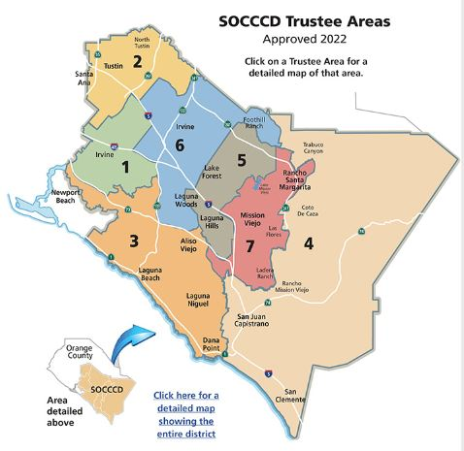
New Areas
The Map
Link on SOCCCD.EDU
Area Map

Slide 19
KEEP IN TOUCH!
Socccdfa.net – our website with info and email: facultyassociation@socccd.edu
mhaeri0@ivc.edu – email me anytime
Contact your school/Division Rep
Contact a grievance chair
Attend Rep Council meetings – First Mondays of the month – open meetings
Spring 2024: Feb 5, Mar 4, Apr 1, May 6
Attend Board of Trustee meetings – Last Monday of the month – open meetings

Slide 20
HAVE A GREAT SEMESTER!

Slide 21
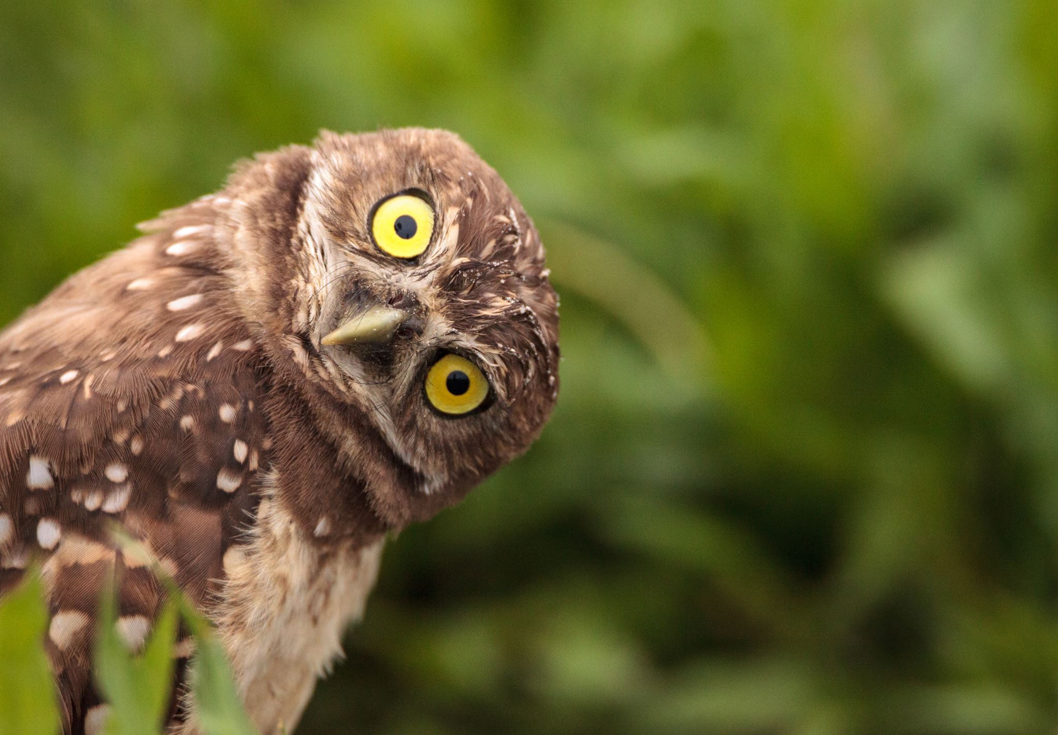
QUESTIONS???

